Slide 1


AIBridge
Lecture 6
Notes:
Going over last week’s lab
How to improve results
prepare to discuss lab 4 key

Slide 2
What makes a good model?
Notes:
Those 3 indicators are called accuracy, precision, and recall, and we will break them down today

Slide 3
Accuracy, Precision, and Recall
Notes:
Something called accuracy is fairly common, and you’ve probably seen accuracy show up in, say a covid test.
But there’s also these other two ways that I want to mention. (click) Precision and recall. Now, there’s always the assumption that accuracy is good enough to quantify everything, but I hope I can convince you otherwise today in this lecture.
Let’s begin by exploring each of these 3 metrics.

Slide 4
Accuracy
“Why is it not enough?”
Notes:
Lets start by exploring accuracy in an example case. And specifically, why accuracy just isn’t enough on its own

Slide 5
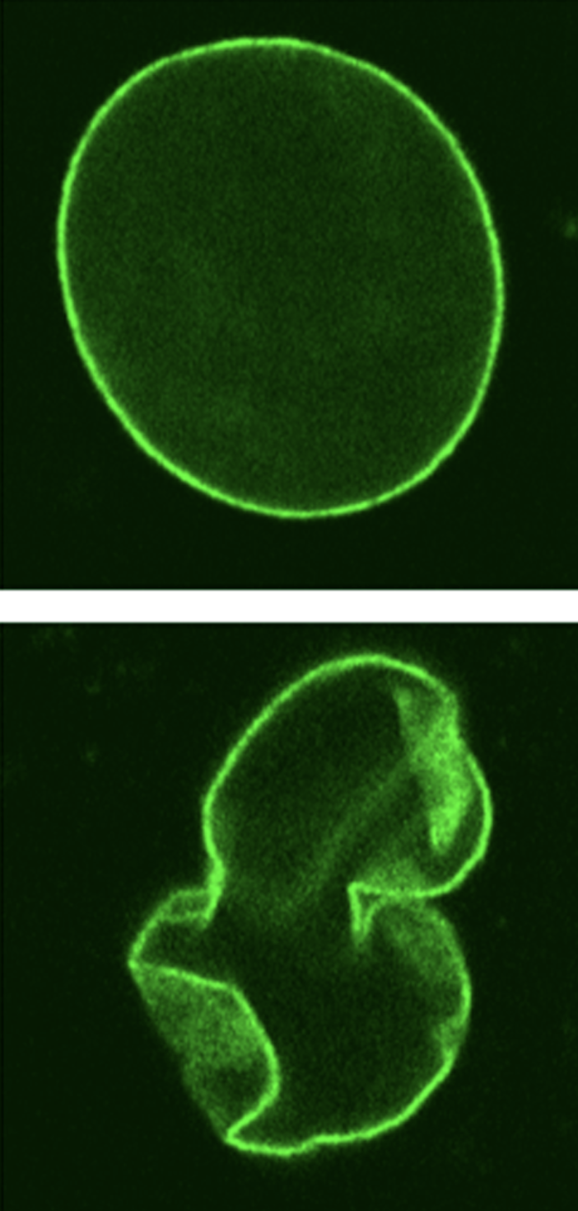
Progeria affects ~159 patients in the US
we have a dataset of all American pediatric patients
Q: If my model predicts with 99.99% accuracy, is it good enough?
Notes:
Progeria is an extremely rare disease that affects just over a hundred patients in the US. Progeria can be identified by the deformed nucleus within a cell. So, (click) let’s say we have a dataset of ALL the hundreds of millions of American pediatric patients…

Slide 6
protein shape
Model
progeria
(yes or no)
Progeria affects ~159 patients in the US
we have a dataset of all American pediatric patients
Notes:
We want to determine if any of the hundreds of millions of patients have progeria, so, we make a model that predict, either yes or no, whether a patient has progeria.

Slide 7

a proposed model:
Model
no progeria regardless
protein shape
actually pretty accurate!
Progeria affects ~159 patients in the US
we have a dataset of all American pediatric patients
Notes:
Now, let me propose a hypothetical model. Lets say, in this model, we take in all the data for one patient, including the nucleus structure, height, allergies, and all other biometrics. And, instead of doing some heavy computations, we just always output (click) no. No progeria. This seems strange, that’s a horrible model. And you would be correct, it doesn’t do anything. However, what do you think its accuracy would be? Exactly, when we calculate its accuracy, (click) it’s nearly 100%. This lets us know how misleading using only accuracy is,

Slide 8
“Selection space”
Notes:
So lets add another layer of abstraction to our situation. here (click) is a funny little shape. Let’s call it the selection space (click). This entire rectangle represents all of the results our model gives us.

Slide 9
“Selection space”
Notes:
First, we will color it in so we can understand it a little easier, while changing the example slightly. Say our model has to predict whether or not a person has covid. Yes or no, so this is classification. This entire rectangle represents all the decisions our models makes, positive or negative, on the patients that we run through the model.
To make it more intuitive, we’ve added the green and red colors to represent the different cases of our model. First, consider the small diamond in the center of the selection space. This represents the entirety of the cases our model predicts as positive, whether it is wrong or right. Next, consider the bigger rectangles of solid colors. These represent all the cases where our model predicts our patient not having covid, no matter if its right or not.
Now, we can start dissecting each of the 4 shapes presented in our covid example

Slide 10
Model selects positive and patient is positive
“Selection space”
Notes:
First, we start with the small light green triangle. Remember, this represents the model predicting a positive case. Here, the small green triangle represents our model being…
…Correct! This triangle shows all the cases when our model classifies a patient as positive and the patient is indeed positive. So light green triangle is when our model did its job correctly.
The small light red section…

Slide 11
Model selects positive and patient is positive
Model selects positive and patient is negative
“Selection space”
Notes:
…represents all the times where our model classifies a patient as positive and the patient is actually negative. So light red triangle is when our model did its job incorrectly.
Next up is the big dark green shape,…

Slide 12
Model selects negative and patient is negative
Model selects positive and patient is positive
Model selects positive and patient is negative
“Selection space”
Notes:
…which represents cases where our model classifies a patient as negative and the patient is indeed negative. So a big dark green shape is when our model did its job correctly.
Lastly, the big dark red shape…

Slide 13
Model selects negative and patient is negative
Model selects positive and patient is positive
Model selects positive and patient is negative
Model selects negative and patient is positive
“Selection space”
Model selects positive
Model selects negative
Patient is positive
Patient is negative
Notes:
Represents the cases where our model classifies a patient as negative when the patient is actually positive. This means the model wasn’t right again

Slide 14
TRUE POSITIVE
TRUE NEGATIVE
TP: Model selects positive and patient is positive
TN: Model selects negative and patient is negative
FALSE POSITIVE
FALSE NEGATIVE
FP: Model selects positive and patient is negative
FN: Model selects negative and patient is positive
“Selection space”
Notes:
Now lets group these examples into instances of the model being right, being wrong, and why. We can see we are left with 4 cases, true/false pos/negs. This represents all of the outputs of our model. Now lets use this figure to understand accuracy.

Slide 15
True Positive
and
True Negative
Accuracy
Overall ability of model
to detect true positives/negatives
“Everything”
Notes:
Accuracy is, (click, read), (click, read.)
Meaning, it is the measure of the overall ability of our model — the number of cases where it was correct divided by the total number of cases, TAKE QUESTIONS (click.)
You may be able to spot a potential issue already, which is that this equation is a bit naive. It sidesteps a lot of the complexity of the classification by only worrying about big picture information.
But don’t get me wrong, accuracy has plenty of use cases. For example, in last week’s lab, the accuracy number is actually what we got from using classifier.score

Slide 16
TP: Model selects positive and patient is positive
TN: Model selects negative and patient is negative
FP: Model selects positive and patient is negative
FN: Model selects negative and patient is positive
“Selection space”
Accuracy
Overall ability of model
Notes:
Ok great! Let’s now tackle precision. (Click)

Slide 17
True Positive
Precision
Accuracy of what we selected.
Or amount of selection that’s actually correct.
Selected Positive
Notes:
In the case of precision, it is the accuracy of what we selected, (click, read), (click, read.) Meaning, it is the measure of the, well, preciseness of the model. (click)
Notice how all the terms here are triangles. Triangles represent times when our model selects positive. Essentially, this equation boils down to: “when we select positive, how often is that correct?” TAKE QUESTIONS

Slide 18
TP: Model selects positive and patient is positive
TN: Model selects negative and patient is negative
FP: Model selects positive and patient is negative
FN: Model selects negative and patient is positive
“Selection space”
Precision
Accuracy
Amount of selection that’s actually correct.
Overall ability of model
Notes:
Ok great! Let’s now tackle recall. (Click)

Slide 19
True Positive
Recall
Accuracy of what we should select.
Or amount of what needs to be selected that is selected
Result Positive
Notes:
For recall, it is (click, read), (click, read).
This is a measure of how much of what we need to select is actually selected. (click)
That probably didn’t make sense, let me explain a bit more. The pattern here is slightly harder to spot: its that all the shapes involved in this equation represent cases where the patient is positive.
Recall essentially boils down to “when there’s a patient that’s positive, how often can we recognize it?”

Slide 20
TP: Model selects positive and patient is positive
TN: Model selects negative and patient is negative
FP: Model selects positive and patient is negative
FN: Model selects negative and patient is positive
“Selection space”
Precision (TP/TP+FP)
Recall (TP/TP+FN)
Accuracy (TP+TN/All)
Amount of selection that’s actually correct.
Amount of what needs to be selected that is selected
Overall ability of model
Notes:
So, let’s summarize. Accuracy is the overall ability of the model. Precision is the amount of the selection that’s actually correct. Recall is the amount of what needs to be selected that’s actually selected. Now we know that it's important to balance all 3 of these characteristics when developing a model. Precision is best when False Positives are bad, Recall is best when False Negatives are bad.

Slide 21
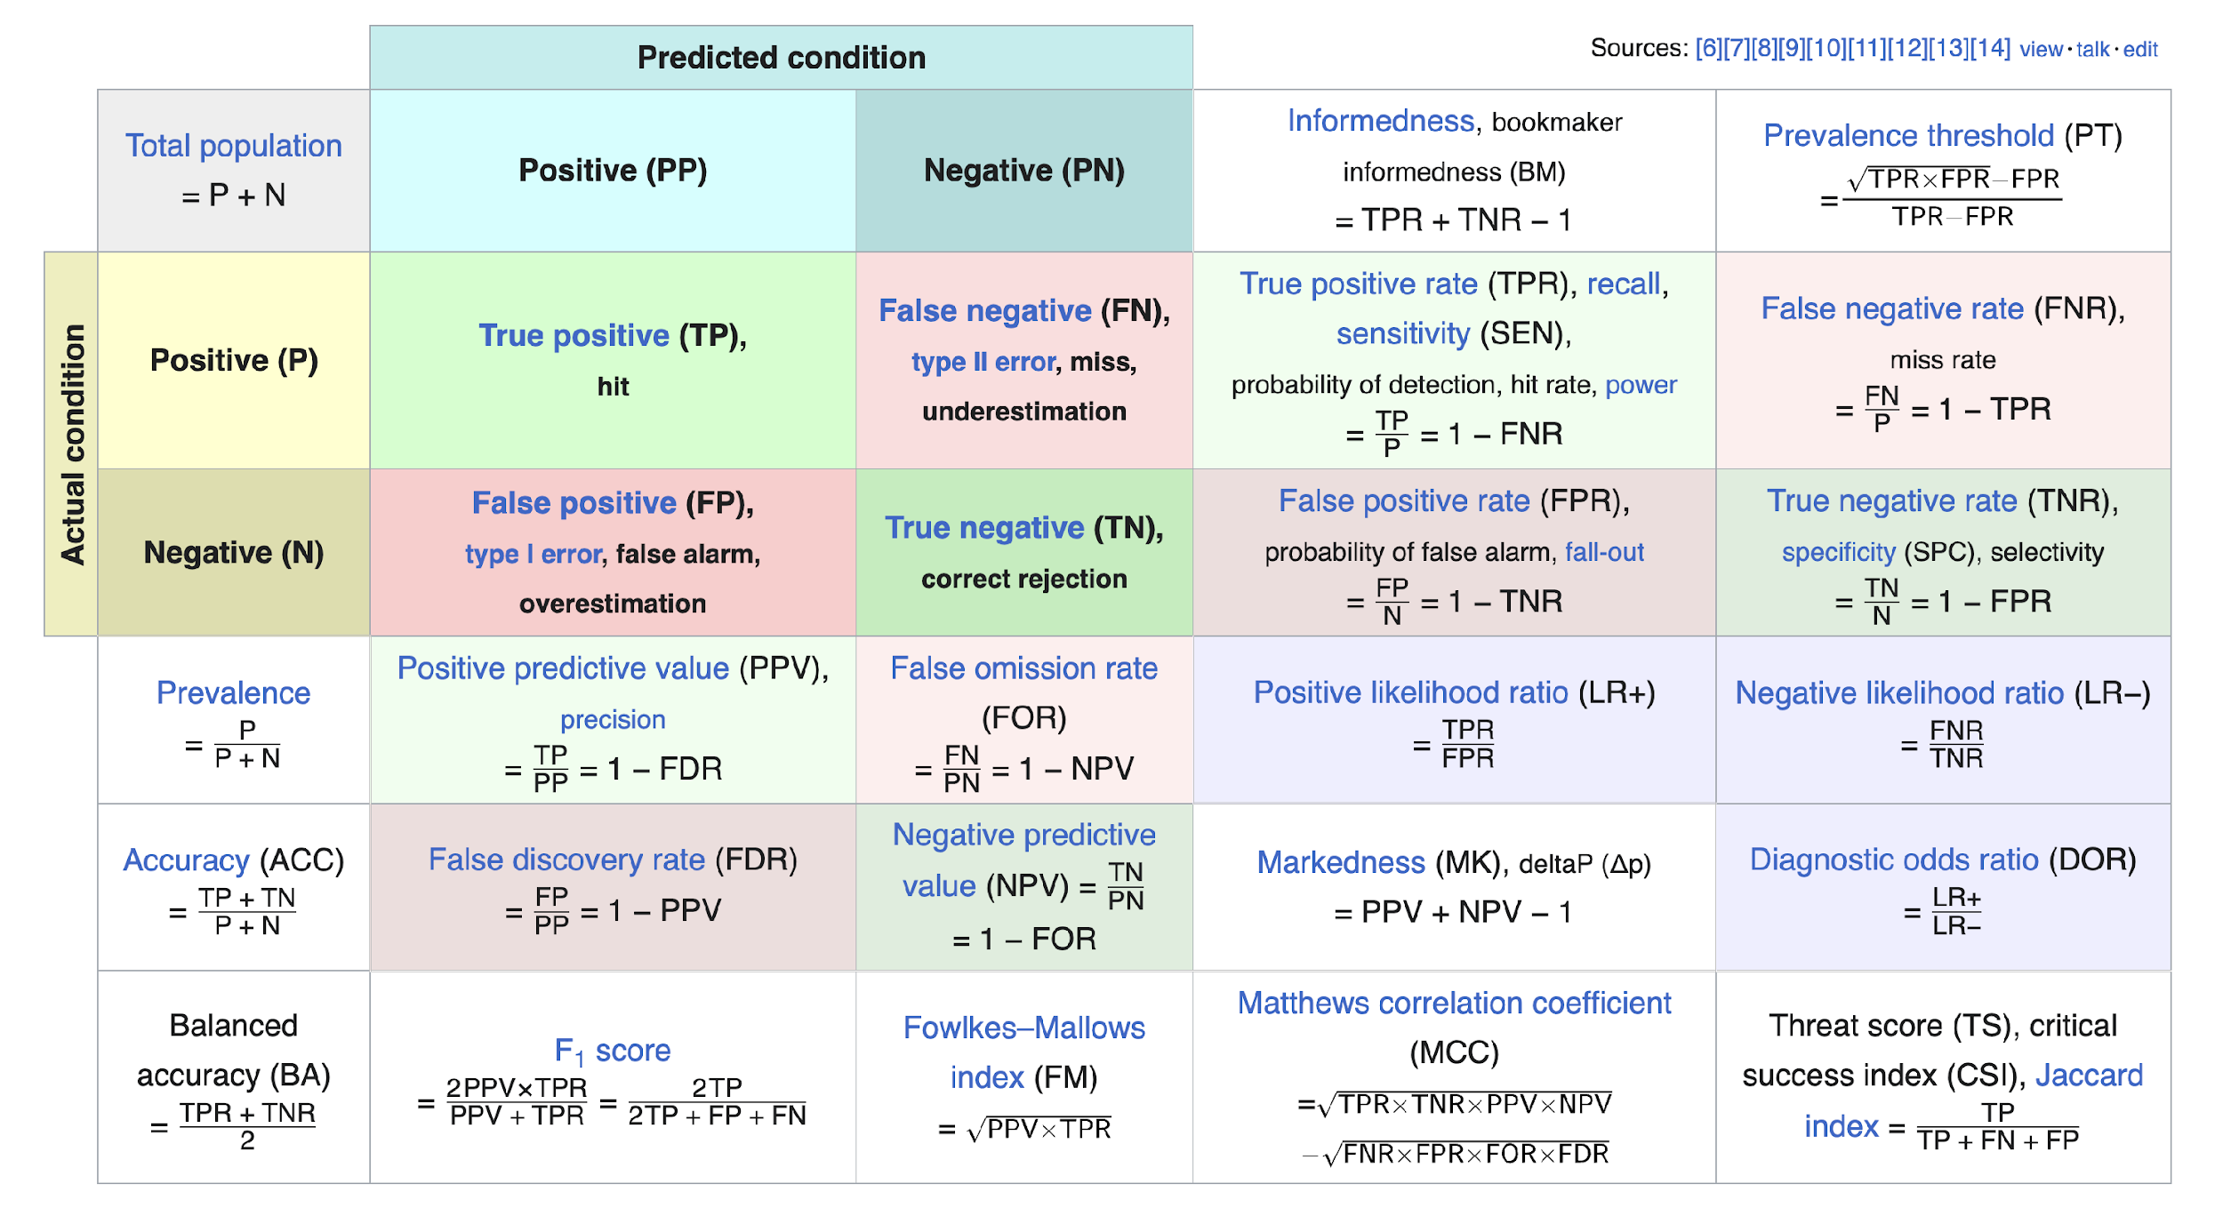
https://en.wikipedia.org/wiki/Precision_and_recall
Notes:
We are

Slide 22
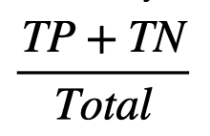
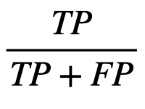

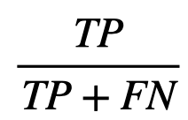
Accuracy
ALWAYS consider the context of your own model!!!
Overall ability of model
Very high, TN ≈ Total
Model
no progeria regardless
Precision
Amount of selection that’s actually correct.
Undefined
Progeria affects ~159 patients in the US
Recall
we have a dataset of all American pediatric patients
Amount of what needs to be selected that is selected
Zero
Notes:
Lets think back to those three characteristics we talked about earlier. The number of true positives in this case would be (click) exactly zero since our model never chooses yes. However, the number of true negatives is in the hundreds of millions. These are the patients that don’t have progeria that our model correctly identified as not having progeria. In this case here, we see that our accuracy will be basically equal to 1, or 100%, despite having a completely useless model. Instead, what we should have used is recall (click), which takes the number of true positives, which is zero in this case, and divides it by the number of true positives and false negatives. The recall of our model is, 0%, which is a much better representation of this hypothetical model.
* in different cases, you should use different metrics
transition over to prof. liu

Slide 23
storytime!
Notes:
Let's do a story time!

Slide 24
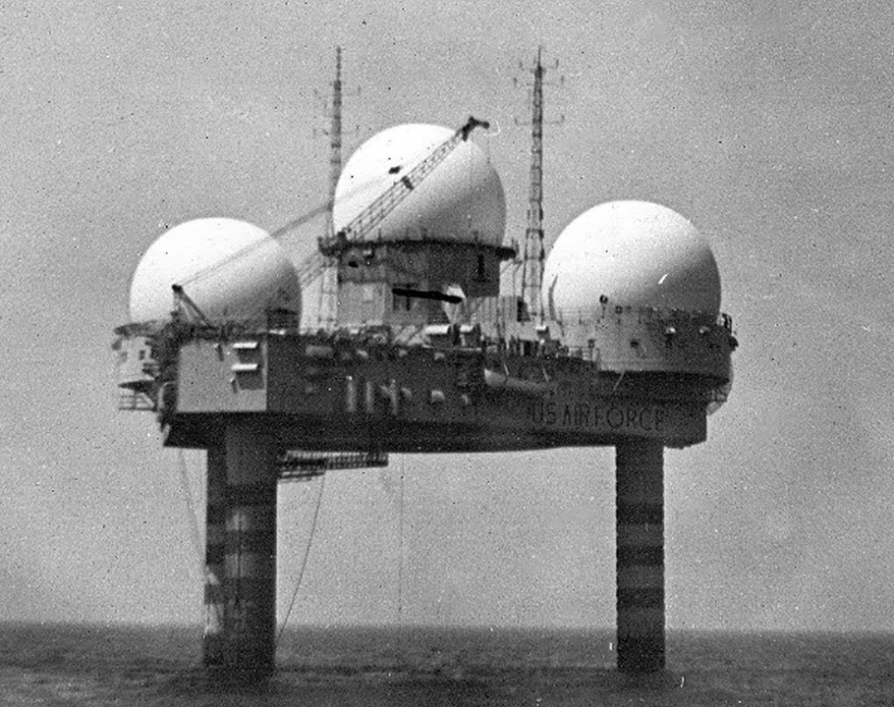
storytime!
Notes:
Radar technology started in WWII, During its early development in WWII, radar played a pivotal role in detecting and intercepting enemy aircraft, greatly improving the effectiveness of air defense systems. Radar detects aircraft by emitting radio waves that bounce off the aircraft and return to the radar antenna, allowing the radar to determine the location, speed, and direction of the aircraft.

Slide 25

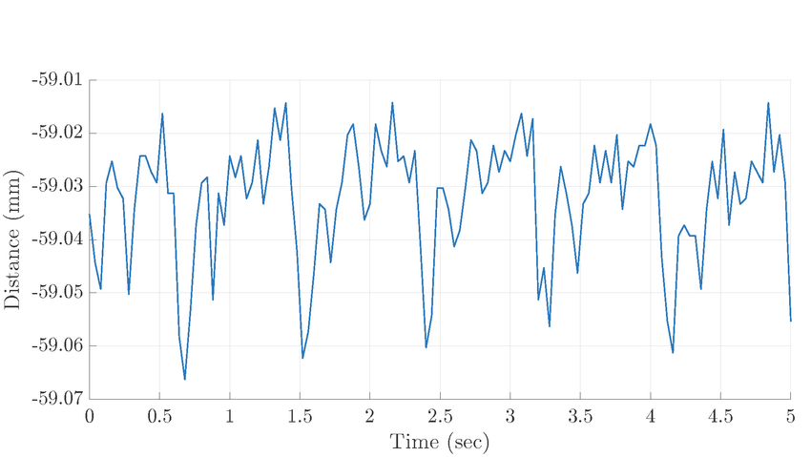

storytime!
does this count as detection?
Notes:
Radar technology started in WWII, During its early development in WWII, radar played a pivotal role in detecting and intercepting enemy aircraft, greatly improving the effectiveness of air defense systems. Radar detects aircraft by emitting radio waves that bounce off the aircraft and return to the radar antenna, allowing the radar to determine the location, speed, and direction of the aircraft.

Slide 26
storytime!
“threshold”
high recall, low precision
Notes:
What about precision recall if my threshold is here?
why is it that high recall no precision?

Slide 27
storytime!
“threshold”
high precision, low recall
Notes:
What about this case?

Slide 28
quantifying
“threshold”
Notes:
So, how do you quantify thresholds?

Slide 29
quantifying
ROC Curve!
“threshold”
Notes:
The answer is ROC, or receiver operation curve, which I think is super cool. So what is it and how do we calculate it?

Slide 30

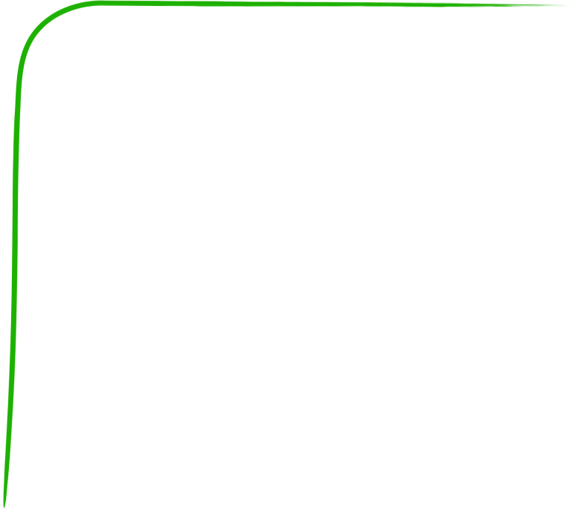

Great!
“Random”
ROC Curve!
True Positive
Receiver Operation Curve
Q: How is a curve generated?
need lots of false positives before detecting a true positive
Awful.
False Positive
ROC Curve quantify the amount of “error”/noise that is necessary for a classifier to make a good prediction
Notes:
An ROC curve is a graph showing the performance of a classification model at all classification thresholds. This includes 2 parameters, the True and False positives at different thresholds. Lowering the threshold for classification will cause more data to be flagged as positive, increasing both true positive and false positive rates, and vis versa for a high classification threshold. The purpose of an ROC curve is to establish the best threshold, meaning whichever classification threshold yields the highest ratio of true to false positives.
Normally, this would mean we had to run a regression analysis (throwback last lesson) on all of the data for each of the thresholds, which is incredibly inefficient.

Slide 31
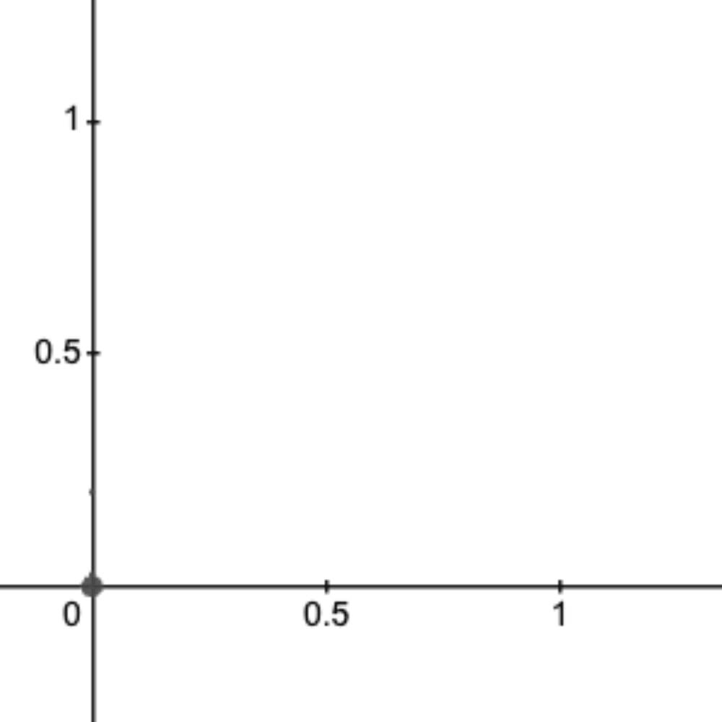
ROC Curve!
True Positive
Receiver Operation Curve
Q: How is a curve generated?
This is a parametric curve
False Positive
ROC Curve quantify the amount of “error”/noise that is necessary for a classifier to make a good prediction
Notes:
An ROC curve is a graph showing the performance of a classification model at all classification thresholds. This includes 2 parameters, the True and False positives at different thresholds. Lowering the threshold for classification will cause more data to be flagged as positive, increasing both true positive and false positive rates, and vis versa for a high classification threshold. The purpose of an ROC curve is to establish the best threshold, meaning whichever classification threshold yields the highest ratio of true to false positives.
Normally, this would mean we had to run a regression analysis (throwback last lesson) on all of the data for each of the thresholds, which is incredibly inefficient.

Slide 32
TPR
How can we quantify ROCs?
FPR
Notes:
Lets run through some examples. Were bringing back the booing and cheering for bad/good curves. What do we think about this curve?

Slide 33
Great!
True Positive
AU(RO)C
area under [the ROC] curve
Q: how do you compare these points
False Positive
Notes:
Instead, we use an algorithm, called AUC (Area under ROC curve), to evaluate how your models work under different thresholds. IN other words, it condenses information to one number, being how accurately your model will rank a random positive case as higher than a random negative case. This condenses lots of information from your data set, so we are losing accuracy for convenience. AUC will then give an estimate of the ratio of true positives to false positives, between 1 and 0 (1 is 100% accurate, 0 is 0%).
AUC is useful for its convenience and speed, as well as its ability to predict a model’s accuracy irrespective of classification threshold. However, AUC is not always the best fit for a model. Sometimes we need incredibly accurate predictions on the probability of a model, such as when diagnosing dangerous diseases, or sometimes we want to prioritize minimizing different types of outputs (like false negatives, going back to the spam email example), which we can’t do with just the AUC value.

Slide 34
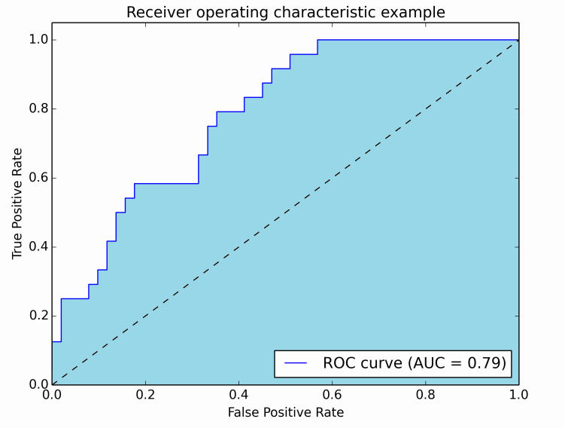
AUROC
area under the ROC curve realistic example

Slide 35
Self-test
Precision–recall AUC
Q: When do we really need it?
Q: what would it look like?
Precision
Especially for unbalanced datasets
Precision
Recall
Amount of selection that’s actually correct.
Amount of what needs to be selected that is selected
Recall
Notes:
This ties back directly with the indicators of a model, precision and recall. Both of these return a number between 0 and 1 of the ratio of correct positive predictions made (precision) and the ratio of correct positive predictions made out of all positive predictions that could have been made (recall). A precision Recall AUC curve is exactly what you expect, a graph of the precision vs the recall of a model at different classification thresholds. As threshold increases and the model predicts more true positives, precision will increase. However as threshold increases the model will predict less positives, so recall will decrease. Its a trade off, so you want to use this AUC curve to find the threshold where you maximize both precision and recall. However, in some situations, like the spam email example, we may want to prioritize recall over precision or vis versa.

Slide 36
more data
what makes models fit better
balanced data
normalized data
quality data
Notes:
Ok, so after all this, what actually makes a model fit better? It all has to do with data. There’s a common principle in computer science: garbage in, garbage out. If you don’t have good inputs, then you shouldn’t expect your outputs to be any good either. You can get better inputs by (click) adding more data, (click) balancing your data, (click), normalizing your data, (click) or getting more quality data.

Slide 37
more data
balanced data
normalized data
quality data
Notes:
(click) Let’s focus first on adding more data (click).

Slide 38
more data
balanced data
normalized data
quality data
Notes:
(click) Let’s focus first on adding more data (click).
if data isn’t perfect: small # of datapoints=more fluctuation, more datapoint s=less fluctuation

Slide 39
more data
more data
more data
Distance
Distance
Lets look at our plane dataset!
Lets look at our plane dataset!
Size on the x axis
Distance on the y axis
Size
Size
Notes:
TRANSITION SLIDE

Slide 40
more data
Distance
Lets look at our plane dataset!
Size on the x axis
Distance on the y axis
Size
Notes:
Going back on track to the lack of data, maybe the few points that were used don’t tell the whole story about the dataset. The result here is that the model doesn’t generalize to the underlying trend of a set of data.

Slide 41
more data
more data
Distance
Lets look at our plane dataset!
Size on the x axis
Distance on the y axis
Size
Notes:
Maybe the few data points we used for training happened to be outliers or maybe their data is inaccurate like this example demonstrates. This can be because I asked for the athletes, who can throw farther. Then the result will be a model that is completely unusable. In this case, can you make a claim about our model’s accuracy, precision and recall? This is a bit of a challenge, as the data is now non binary. How could we convert this non binary data into something generalizable to true/false positives/negatives? Remember what our model is trying to predict, and the results it gives Turn and talk with your neighbor for a minute about this
So the trick was to relate the qualitative data to our line of best fit, which our model predicted. You can clearly see that most of our data is under the line, meaning that our model predicted the quality of the wine was BETTER than it actually was. This is equivalent to a false positive in our case. With all the false positives of our model, we now know that the accuracy is low (all true pos, yet no true negs), the precision is low (all true pos, yet much more false pos), and the recall is high (all true pos, and no false neg)

Slide 42
more data
more data
Distance
Lets look at our plane dataset!
Size on the x axis
Distance on the y axis
Size
Notes:
Maybe the few data points we used for training happened to be outliers or maybe their data is inaccurate like this example demonstrates. This can be because I asked for the athletes, who can throw farther. Then the result will be a model that is completely unusable. In this case, can you make a claim about our model’s accuracy, precision and recall? This is a bit of a challenge, as the data is now non binary. How could we convert this non binary data into something generalizable to true/false positives/negatives? Remember what our model is trying to predict, and the results it gives Turn and talk with your neighbor for a minute about this
So the trick was to relate the qualitative data to our line of best fit, which our model predicted. You can clearly see that most of our data is under the line, meaning that our model predicted the quality of the wine was BETTER than it actually was. This is equivalent to a false positive in our case. With all the false positives of our model, we now know that the accuracy is low (all true pos, yet no true negs), the precision is low (all true pos, yet much more false pos), and the recall is high (all true pos, and no false neg)

Slide 43
more data
Distance
Lets look at our plane dataset!
Size on the x axis
Distance on the y axis
Size
use more data, get more accurate results
Notes:
So long as the data is collected and used consistently, adding more data for your model to train on will generally improve its performance.
One extra thing to note is that you don’t always have to go out and collect more data to increase the amount of data. There is a technique called Data Augmentation where you can adjust already existing samples of data to generate additional samples. For example, if your dataset has images, maybe you adjust the contrast or saturation of the image or flip the image horizontally or maybe crop off an edge of the image. However, this isn’t really possible for all datasets, such as the dataset’s we’re using. Also, when we augment data, we have to be careful about the claims we make using our model. If you just make up your own data, your model can quickly become skewed and fail to predict from a realistic dataset

Slide 44
more data
balanced data
normalized data
quality data
Notes:
More data is not only more datapoints. It has another meaning. Can anyone think of it? Let’s take a look at the next slide.

Slide 45
more data
balanced data
normalized data
quality data

Slide 46
Let’s think about logistic functions!
balanced data
Notes:
(click) and a bit of logistic functions (click).

Slide 47
Let’s think about logistic functions!
balanced data
White
Red
in an ideal world
…but no
Notes:
In an ideal world (click), we would have a perfectly even balance of data. For the wine dataset, it would be exactly 50% white wine and 50% red wine. Unfortunately (click), we don’t live in a perfect world (click).

Slide 48
Let’s think about logistic functions!
balanced data
4898
1599
White
Red
What happens when we fit this dataset entirely?
Notes:
In reality, the dataset looks something like this.
(click) nearly 5000 samples of white wine,
(click) but only 1500 samples of red wine.
(click) so, what are the consequences of this uneven split? Well, due to the differing acidity of the types of wine, the model is going to be skewed. Let’s see what happens when a logistical model tries to fit this dataset.

Slide 49

Let’s think about logistic functions!
balanced data
Red
White
pretty well defined!
Acidity
Notes:
(click) {line 1}
(click) {line 2}
(click) {line 3}
In this exaggerated picture, we have 3 possible ways a model can conceivably fit this dataset. In the bottom left here,
(click) you see there’s a lot of data points representing white wine, so the line is pretty well defined here. Visually, this means all the lines are closer together.

Slide 50

Let’s think about logistic functions!
balanced data
Red
much more divergent
White
pretty well defined!
Acidity
balanced data, more accurate results
Notes:
In the top right however, you can see that the lines are a lot more divergent.
(click) You can think of this from the model’s perspective, it wants to minimize the total distances to every point. So, the easiest way for it to decrease the total distances is to bend more around the white wine data where more of the points are, and it can care less about the red wine because there’s less points.
(click) In general, this is why more balanced your data is more accurate, as the model will more accurate account for the inherent differences between data points in your set

Slide 51
more data
balanced data
normalized data
quality data
Notes:
Now let's shift to normalizing data

Slide 52
more data
balanced data
normalized data
quality data

Slide 53
normalized data
Acidity
120
90
60
30
Sulfur Dioxide
30
60
90
120
Notes:
Here’s another hypothetical dataset. We have the Sulfur Dioxide (characterizing the sugar content, or sweetness) of the wine on the x-axis and the quality of the wine on the y-axis. There are two classes of wine here, red and wine, each labeled with its corresponding color.
The goal here is a bit different from the normal regression problem. Here we want to fit a line that best separates the two classes.
We can see that the numbers for residual sugar are a lot larger than that for wine quality: Wine acidity only goes up to a maximum of 10 while residual sugar can go up to about 120.
There’s a problem here, and it may not be obvious at first, but it’s important. To demonstrate, let’s once again try to fit this data with a line that best separates the two classes.

Slide 54
normalized data
Acidity
120
90
60
???
30
Sulfur Dioxide
30
60
90
120
Notes:
And here’s what the separation line looks like.
Ok, nothing terrible right?
But let’s get the equation of that line (click), and here’s where problems start happening.
It looks something like this. That constant for y is 3, which is disproportionately large in comparison to the constant of x, which is just 1. This basically means that Acidity has a larger impact on the output of the model simply because its numbers have a larger range.
This may be fine when we only have 2 variables, but as we add even more dimensions, the Acidity value is going to drown out the values of any other input we add.
So how do we solve this? Once again, it has to do with our data. We need to re-distribute our data but instead using a smaller range of numbers. Let’s say we want all our data to be distributed between 0 and 1. (click)

Slide 55
normalized data
Acidity
1.00
much better
0.75
0.50
0.25
Sulfur Dioxide
0.25
0.50
0.75
1.00
normalized data, better generalization, faster convergence
Notes:
As we scale all the data to the desired range, notice how that the trend in the data remains the same. We aren’t drastically altering our data, just scaling them by a certain amount. And let’s see what our line and its equation looks like now. (click) (click)
And its constants look a lot better! (click)
This process of scaling data is called normalization. (click) When working with normalized data, models can more easily generalize to patterns.

Slide 56
more data
balanced data
normalized data
quality data
Notes:
Finally, we can assess the quality of the data

Slide 57
more data
balanced data
normalized data
quality data
Notes:
But what even is quality data. It's a little bit harder to define than wine, and it consists of more abstract terms than just how the data was made/created

Slide 58
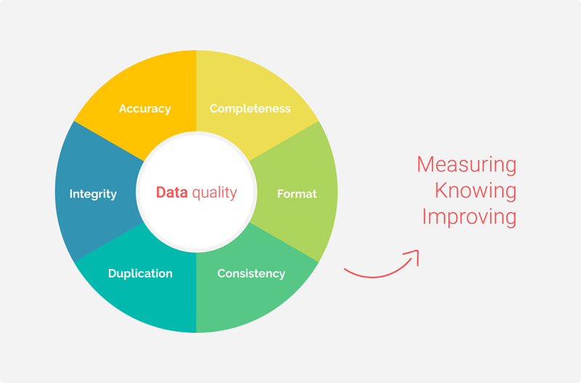
Image credit: Passionned Group
Notes:
This graph is a great visualization of what quality data actually means. Here we can see the different aspects of quality data. Lets go through them quickly. First of all, data should be accurate, meaning it should truthfully represent whatever population it was taken from. This also extends to integrity, which we briefly touched on before when we discussed data augmentation, which could compromise the integrity of data by deviating from the population. Data integrity includes accuracy and comprehensiveness. The data should also be consistent and replicable, meaning it can be corroborated if new data sets are taken. It should also be formatted properly so others can view the data, as well as complete, meaning that there was no exclusion of third variables which could have influenced the relationship that your model predicts.
Overall, data quality, which is determined by the collection of the data itself, is incredibly important. Making a good model isn’t just about coding and understanding the math behind it, it starts by trying to make your data as representative of the real world as possible.

Slide 59
more data
balanced data
normalized data
quality data
Notes:
So now, we know the 4 aspects of data which will improve our model!As a recap,
More Data: adding more data to your dataset to get a more accurate model
Balanced Data: making sure there’s even amounts of each type of data to get a more accurate model.
Normalized Data: making sure all your data points have values close to one another to get a more accurate model.
Quality Data: making sure your data collection is accurate and inclusive

Slide 60
Missing Data

Slide 61
Remove
Missing Data
Use mean/most often
Regression to fill in

Slide 62
remove
Missing Data
Use mean/most often
Regression
KNN

Slide 63
Which of the following methods can be used to balance an imbalanced dataset?
a) Standardization
b) Data augmentation
c) Cross-validation
d) Feature selection

Slide 64
What does data normalization aim to achieve in a dataset?
a) To increase the dataset size
b) To adjust the values to a common scale without distorting differences in the ranges of values
c) To encode categorical variables
d) To remove outliers from the data

Slide 65
Why is high-quality data important in machine learning?
a) It reduces the need for model evaluation
b) It ensures the model performs well only on the training data
c) It reduces noise and potential errors, leading to better model performance
d) It increases the complexity of the model

Slide 66
In the context of machine learning, what is one way to handle missing data to maintain high data quality?
a) Increase the size of the dataset
b) Remove all features with any missing values
c) Use imputation methods to fill in the missing values
d) Ignore the missing values and proceed with training
Notes:
c)

Slide 67
Why is having more data generally beneficial for a machine learning model?
a) It always increases the model's complexity
b) It reduces the risk of overfitting
c) It allows the model to learn better patterns and generalize well
d) It makes the training process faster
Notes:
Both b) and c)

